Slide 1
ATAI
Advanced Technique of Artificial Intelligence
ATAI
ChongqingUniversity _{AdvancedTechniqueof}
of Technology Artificial Intelligence
Chongqing University of
Technology
Chongqing University ^{ATAI}
_{of Technology} Advanced Techniqueof
Artificial Intelligence
Chongqing University of Technology
Chongqing University of Technology
Multiple Purchase Chains with Negative Transfer Elimination
for Multi-Behavior Recommendation
Code : https://github.com/VanillaCreamer/MPC
—— AAAI’2025
2025.6.19. • ChongQing
Reported by YaoYao Zhang
1

Slide 2
ATAI
Advanced Technique of Artificial Intelligence
ATAI
ChongqingUniversity _{AdvancedTechniqueof}
of Technology Artificial Intelligence
Chongqing University of
Technology
Chongqing University ^{ATAI}
_{of Technology} Advanced Techniqueof
Artificial Intelligence
Chongqing University of Technology
Chongqing University of Technology
Motivation
i) existing worksconsider only a single chain from auxiliary behaviors to the target behavior, referred to as a purchase chain , ignoring other valuable purchase chains.
ii) Most studies presume that interacted items in auxiliary behaviors are good for recommendations,and pay little attention to the negative transfer problem.

Slide 3
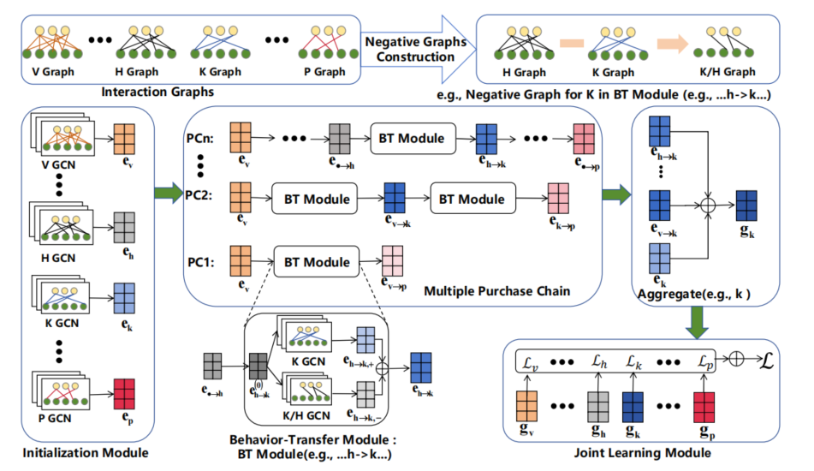
ATAI
Advanced Technique of Artificial Intelligence
ATAI
ChongqingUniversity _{AdvancedTechniqueof}
of Technology Artificial Intelligence
Chongqing University of
Technology
Chongqing University ^{ATAI}
_{of Technology} Advanced Techniqueof
Artificial Intelligence
Chongqing University of Technology
Chongqing University of Technology

Slide 4
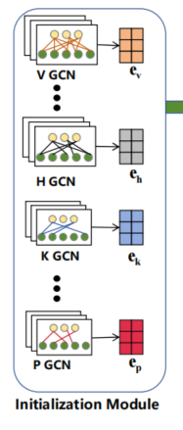
ATAI
Advanced Technique of Artificial Intelligence
ATAI
ChongqingUniversity _{AdvancedTechniqueof}
of Technology Artificial Intelligence
Chongqing University of
Technology
Chongqing University ^{ATAI}
_{of Technology} Advanced Techniqueof
Artificial Intelligence
Chongqing University of Technology
Chongqing University of Technology
Method

Slide 5
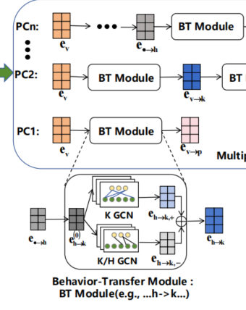
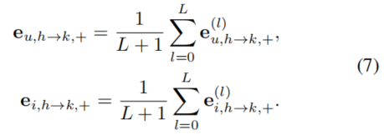
ATAI
Advanced Technique of Artificial Intelligence
ATAI
ChongqingUniversity _{AdvancedTechniqueof}
of Technology Artificial Intelligence
Chongqing University of
Technology
Chongqing University ^{ATAI}
_{of Technology} Advanced Techniqueof
Artificial Intelligence
Method
Chongqing University of Technology
Chongqing University of Technology

Slide 6
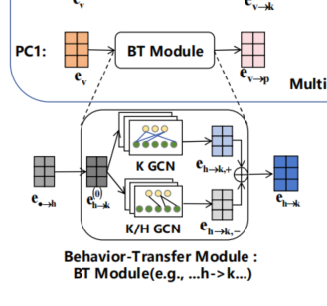
ATAI
Advanced Technique of Artificial Intelligence
ATAI
ChongqingUniversity _{AdvancedTechniqueof}
of Technology Artificial Intelligence
Chongqing University of
Technology
Chongqing University ^{ATAI}
_{of Technology} Advanced Techniqueof
Artificial Intelligence
Method
Chongqing University of Technology
Chongqing University of Technology

Slide 7
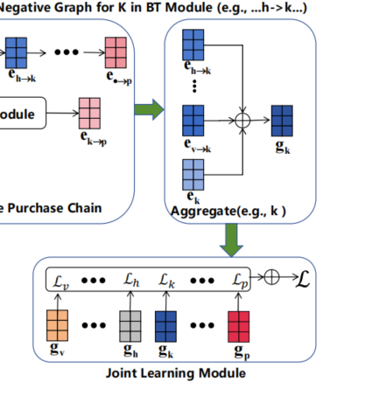
ATAI
Advanced Technique of Artificial Intelligence
ATAI
ChongqingUniversity _{AdvancedTechniqueof}
of Technology Artificial Intelligence
Chongqing University of
Technology
Chongqing University ^{ATAI}
_{of Technology} Advanced Techniqueof
Artificial Intelligence
Method
Chongqing University of Technology
Chongqing University of Technology

Slide 8
ATAI
Advanced Technique of Artificial Intelligence
ATAI
ChongqingUniversity _{AdvancedTechniqueof}
of Technology Artificial Intelligence
Chongqing University of
Technology
Chongqing University ^{ATAI}
_{of Technology} Advanced Techniqueof
Artificial Intelligence
Chongqing University of Technology
Experiments
Chongqing University of Technology

Slide 9
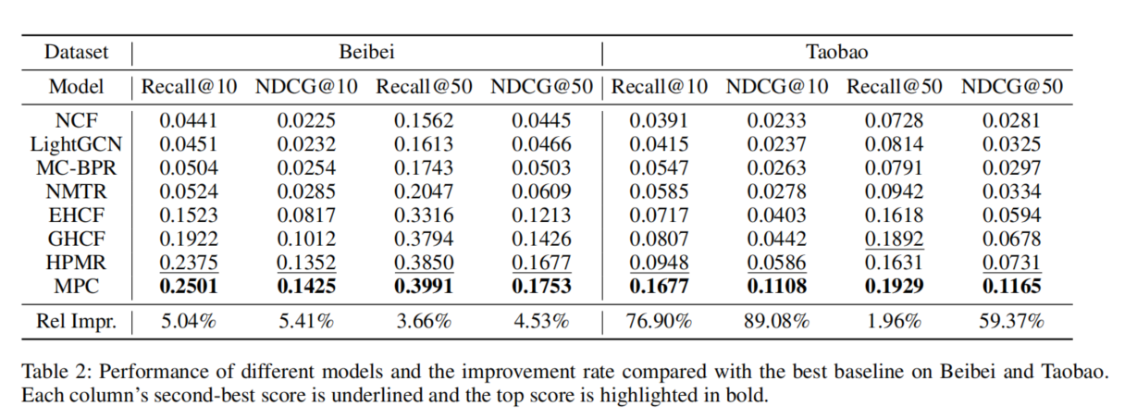
ATAI
Advanced Technique of Artificial Intelligence
ATAI
ChongqingUniversity _{AdvancedTechniqueof}
of Technology Artificial Intelligence
Chongqing University of
Technology
Chongqing University ^{ATAI}
_{of Technology} Advanced Techniqueof
Artificial Intelligence
Chongqing University of Technology
Chongqing University of Technology

Slide 10
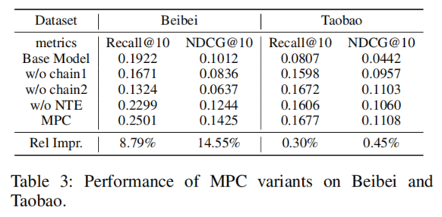
ATAI
Advanced Technique of Artificial Intelligence
ATAI
ChongqingUniversity _{AdvancedTechniqueof}
of Technology Artificial Intelligence
Chongqing University of
Technology
Chongqing University ^{ATAI}
_{of Technology} Advanced Techniqueof
Artificial Intelligence
Chongqing University of Technology
Chongqing University of Technology

Slide 11
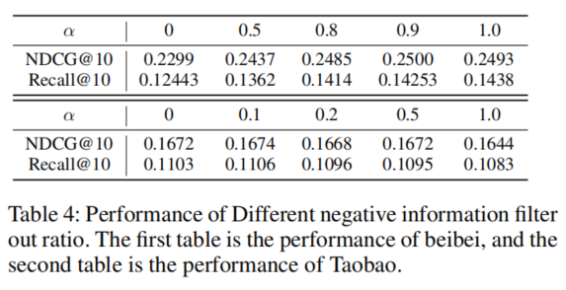
ATAI
Advanced Technique of Artificial Intelligence
ATAI
ChongqingUniversity _{AdvancedTechniqueof}
of Technology Artificial Intelligence
Chongqing University of
Technology
Chongqing University ^{ATAI}
_{of Technology} Advanced Techniqueof
Artificial Intelligence
Chongqing University of Technology
Chongqing University of Technology

Slide 12
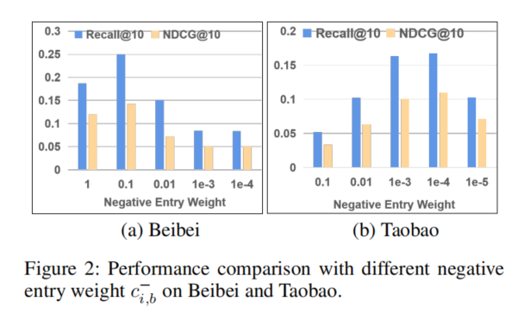
ATAI
Advanced Technique of Artificial Intelligence
ATAI
ChongqingUniversity _{AdvancedTechniqueof}
of Technology Artificial Intelligence
Chongqing University of
Technology
Chongqing University ^{ATAI}
_{of Technology} Advanced Techniqueof
Artificial Intelligence
Chongqing University of Technology
Chongqing University of Technology

Slide 13
ATAI
Advanced Technique of Artificial Intelligence
ATAI
ChongqingUniversity _{AdvancedTechniqueof}
of Technology Artificial Intelligence
Chongqing University of
Technology
Chongqing University ^{ATAI}
_{of Technology} Advanced Techniqueof
Artificial Intelligence
Chongqing University of Technology
Chongqing University of Technology
Thanks!

